Slide 1
Wireless Signal Source Localization by Unmanned Aerial Vehicle using AERPAW Digital Twin and Testbed
Baisakhi Chatterjee, Sonali Chaudhari, Zhizhen Li, Dr. Yuchen Liu & Dr. Rudra Dutta
Department of Computer Science, North Carolina State University, USA
Presented by: Zifan Zhang

Slide 2







Introduction
Autonomous UAVs have a variety of applications
Network Coverage
Search and Rescue
Traffic Surveillance
Major problem faced by researchers is real-world testing
AERPAW provides remote access to researchers for flexible and programmable experiments
Our goal - demonstrate the differences observed when an experiment is run in the AERPAW emulation environment versus the actual testbed
Notes:
Network coverage is the problem of optimizing the placement of mobile stations to increase connectivity between groups of users. UAVs are uniquely suited for this task. Another activity where UAVs thrive is that of Search and Rescue. UAVs can locate groups of survivors in potentially dangerous conditions and alert rescue organizations. Traffic surveillance, too benefits from the UAVs usage. These devices can monitor traffic patterns and detect anomalous behaviours.

Slide 3
Motivation
The AERPAW testbed allows researchers to develop algorithms in a Digital Twin emulation environment and validate the outcome in the real world.
Our goal was to observe and analyze how real-world conditions could add to uncertainties which were not present in the emulation environment
Localizations is thus uniquely suited as an exemplar problem for our task.
Localization is the problem of determining the position of an object by measuring some emission like odor, sound, or radio waves
It has a variety of applications and is rapidly becoming an area of considerable interest
Problems can consist of finding the source of a pollutant or gaseous leak, to locating a sound
For our project, the UAV must find the source of a radio signal emitted by a UGV hidden in a field
Notes:
With the increase in potential UAV applications, it has become critical to develop and test mission-specific algorithms without compromising safety.
Validating infrastructure-intensive algorithms in the field is not feasible for every researcher

Slide 4
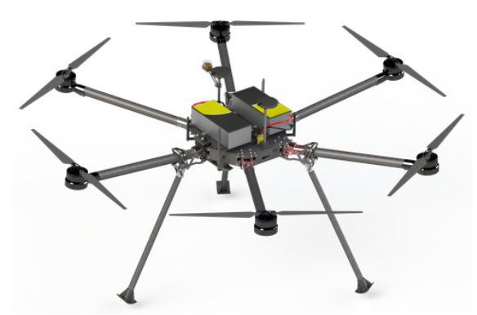
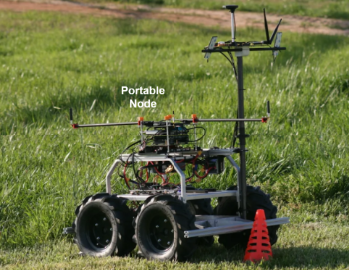
AERPAW Architechture
Aerial Experimentation and Research Platform for Advanced Wireless (AERPAW) is a national aerial wireless experimentation platform
AERPAW is a batch-mode facility consisting of a set of virtual computing nodes, each aligning with a physical AERPAW computing node, which is the Digital Twin of ground conditions
Hardware Nodes –
Fixed Nodes – Base Station
Portable Nodes – UAV & UGV
Software Libraries –
Programmable Entities – Exposed to the user and can be modified as required
Backplane – Responsible for isolating the platform with the rest of the world and the experiments from each other.
Images courtesy of AERPAW Website
Notes:
We only talk about the nodes relevant to our project
batch-mode facility -- meaning that jobs are processed in batches. Initiating development is automated, but actual testbed executions are still human operated. Hidden Slide explains batch mode

Slide 5
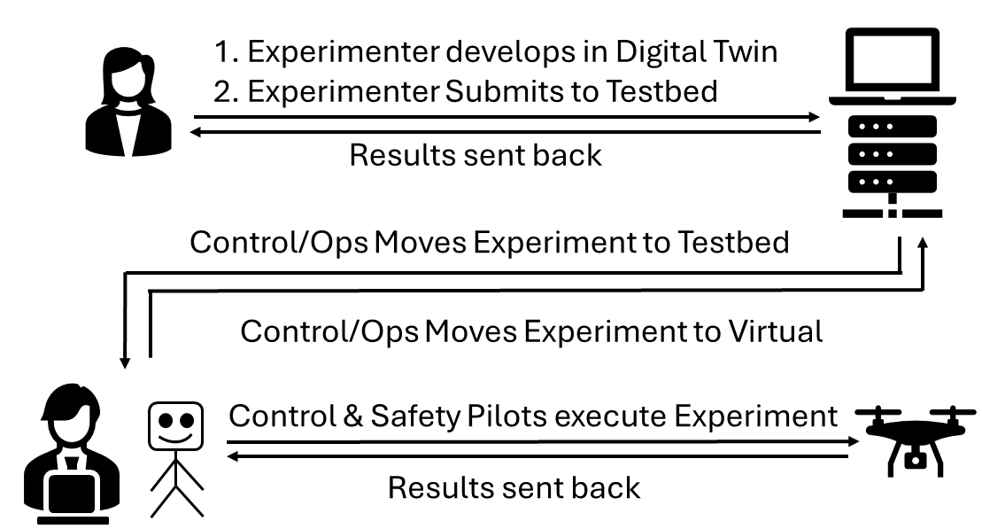
Batch Mode Access

Slide 6
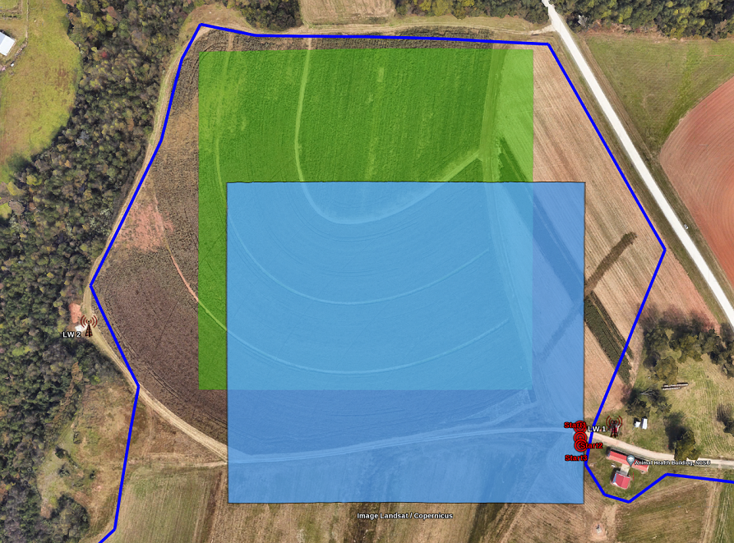
Problem Model
The UGV is hidden somewhere in the green square and constantly emits a signal
A software-defined radio (SDR) carried by the UAV will continuously receive a channel-sounding waveform
The UAV is allowed to fly in the light blue square only
The dark blue line indicates general boundary
Location estimates are collected at 3-minute and 10-minute marks
Image courtesy of AERPAW Website
Notes:
We only talk about the nodes relevant to our project

Slide 7
OUR APPROACH

Slide 8
Overview
To localize the source, we adopted the Linear Least Square method
We estimate the position of the rover based on repeated sampling of the received signal
The UAV traverses the allowed area of flight using waypoints
At each location, the UAV takes 5 measurements based on which it estimates signal source
We have assumed the UAV will maintain a Line of Sight (LoS) connectivity
After 10 minutes, the UAV returns to its home location
Image courtesy of AERPAW Website
Notes:
We only talk about the nodes relevant to our project

Slide 9
Trajectory Control
AERPAW uses NED (North East Down) positioning system
Initially the UAV takes off from its home location
UAV flies to first location on its waypoint
UAV traverses all waypoints
Once all waypoints are exhausted, the UAV keeps flying straight
If it hits the boundary it turns right
4
5
6
7
3
2
8
1
T
T
Image courtesy of AERPAW Website
Notes:
Fly straight = in whatever direction it was facing

Slide 10


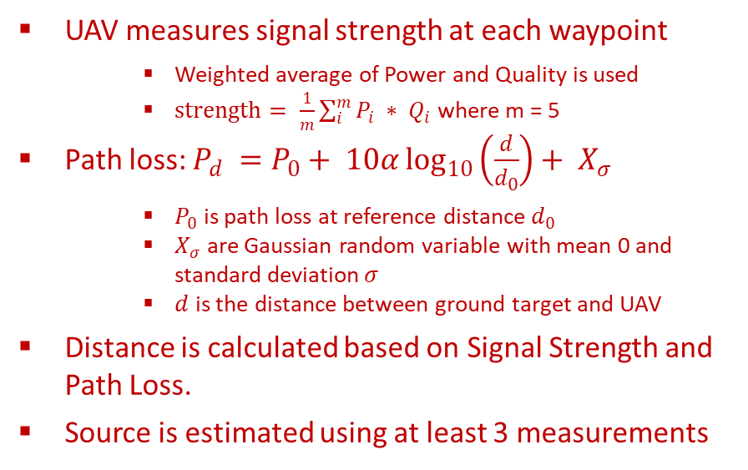
Source Estimation
UAV measures signal strength at each waypoint
Weighted average of Power and Quality is used
$strength= \frac{1}{m}\sum_{i}^{m}{P_{i} ∗ Q_{i}}$ where m = 5
Path loss: $P_{d} =P_{0}+ 10α\log_{10}\left(\frac{d}{d_{0}}\right)+ X_{σ}$
$P_{0}$ is path loss at reference distance $d_{0}$
$X_{σ}$ are Gaussian random variable with mean 0 and standard deviation$σ$
$d$ is the distance between ground target and UAV
Distance is calculated based on Signal Strength and Path Loss.
Source is estimated using at least 3 measurements
Source Estimate
3
2
1
T
T
Image courtesy of AERPAW Website
Notes:
Fly straight = in whatever direction it was facing

Slide 11
TESTING & RESULTS

Slide 12
Testing Setup
Testing was conducted in two phases – Emulation and Testbed
Emulation Testing is the first stage of verification
Ensures regulations and safety criteria are met
Emulation mimics ground conditions
Each node runs in a container with monitoring and overriding capabilities
Testbed is the final stage of testing where AERPAW Operators execute the code on an actual UAV
Three tests were conducted with the Source in different locations
For each test, estimates were recorded at 3-minute and 10-minute marks
Image courtesy of AERPAW Website

Slide 13
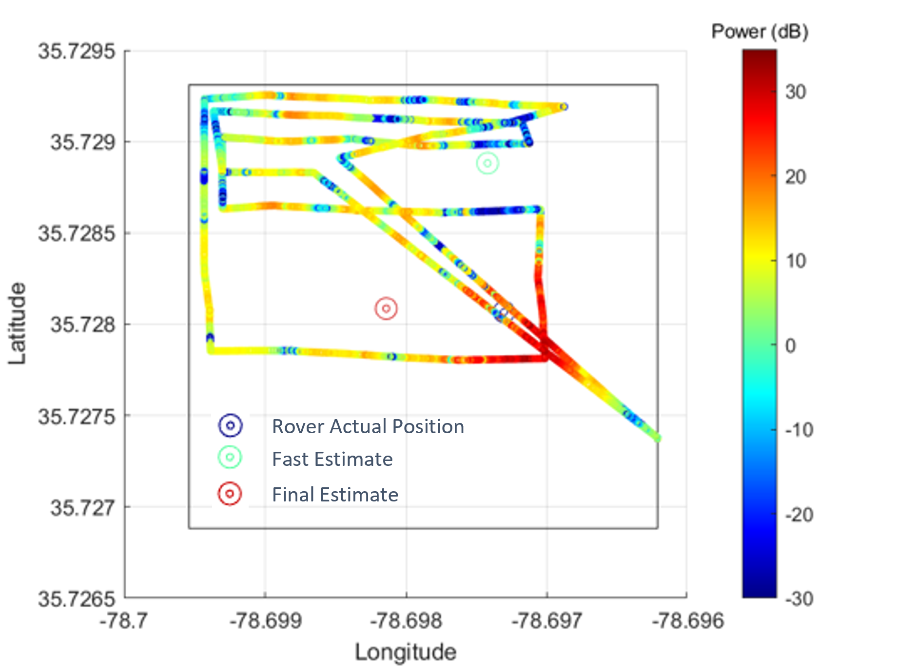
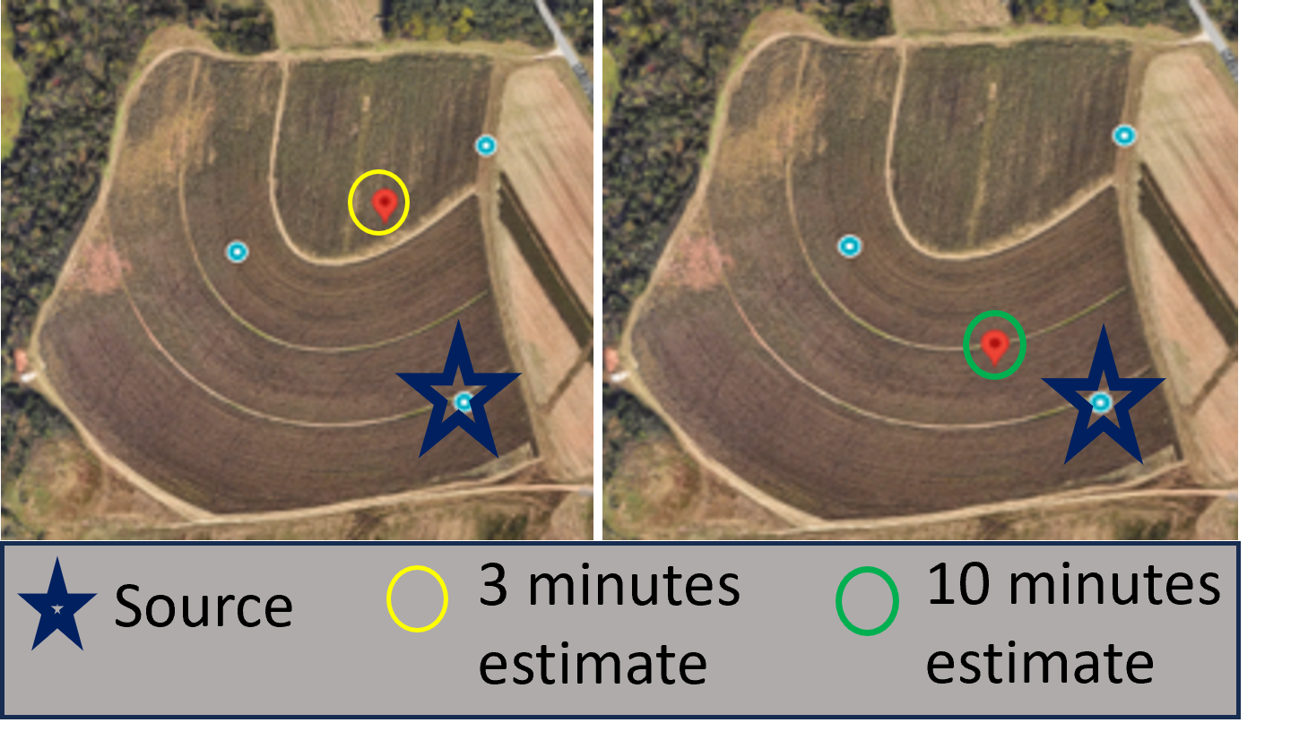
Test Case 1 : Rover Close to UAV Starting Point
Emulation
Error 3-min : 92.4m
Error 10-min : 155.4m
Test Bed
Error 3-min : 91.6m
Error 10-min : 93.1m

Slide 14
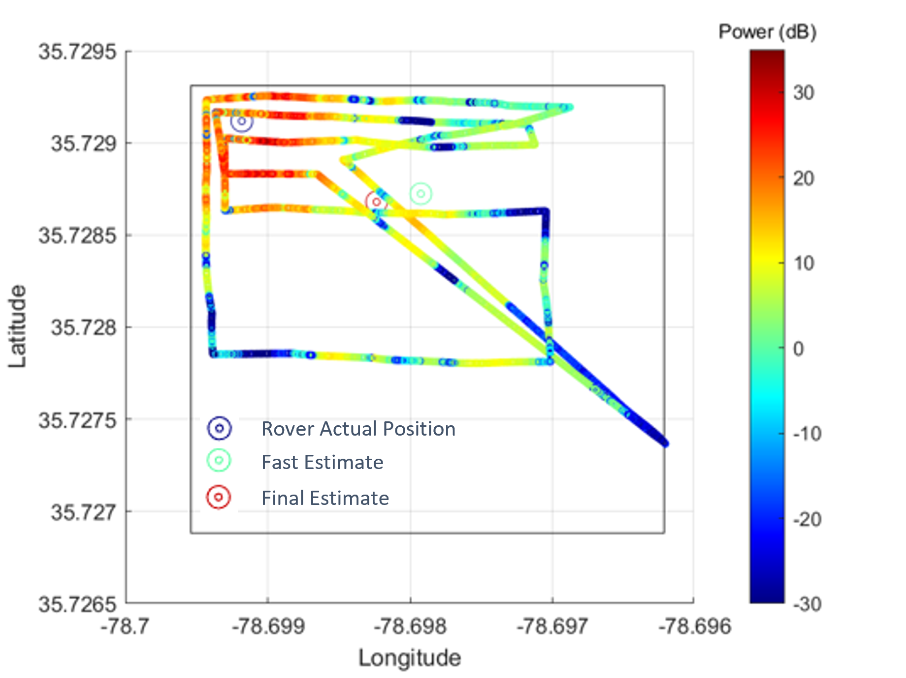
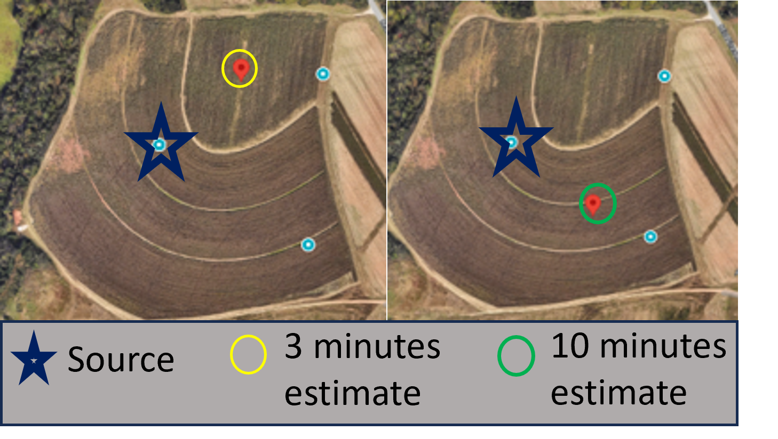
Test Case 2 : Rover Far From UAV Starting Point
Emulation
Error 3-min : 152.7m
Error 10-min : 134.1m
Test Bed
Error 3-min : 146.7m
Error 10-min : 116.2m

Slide 15
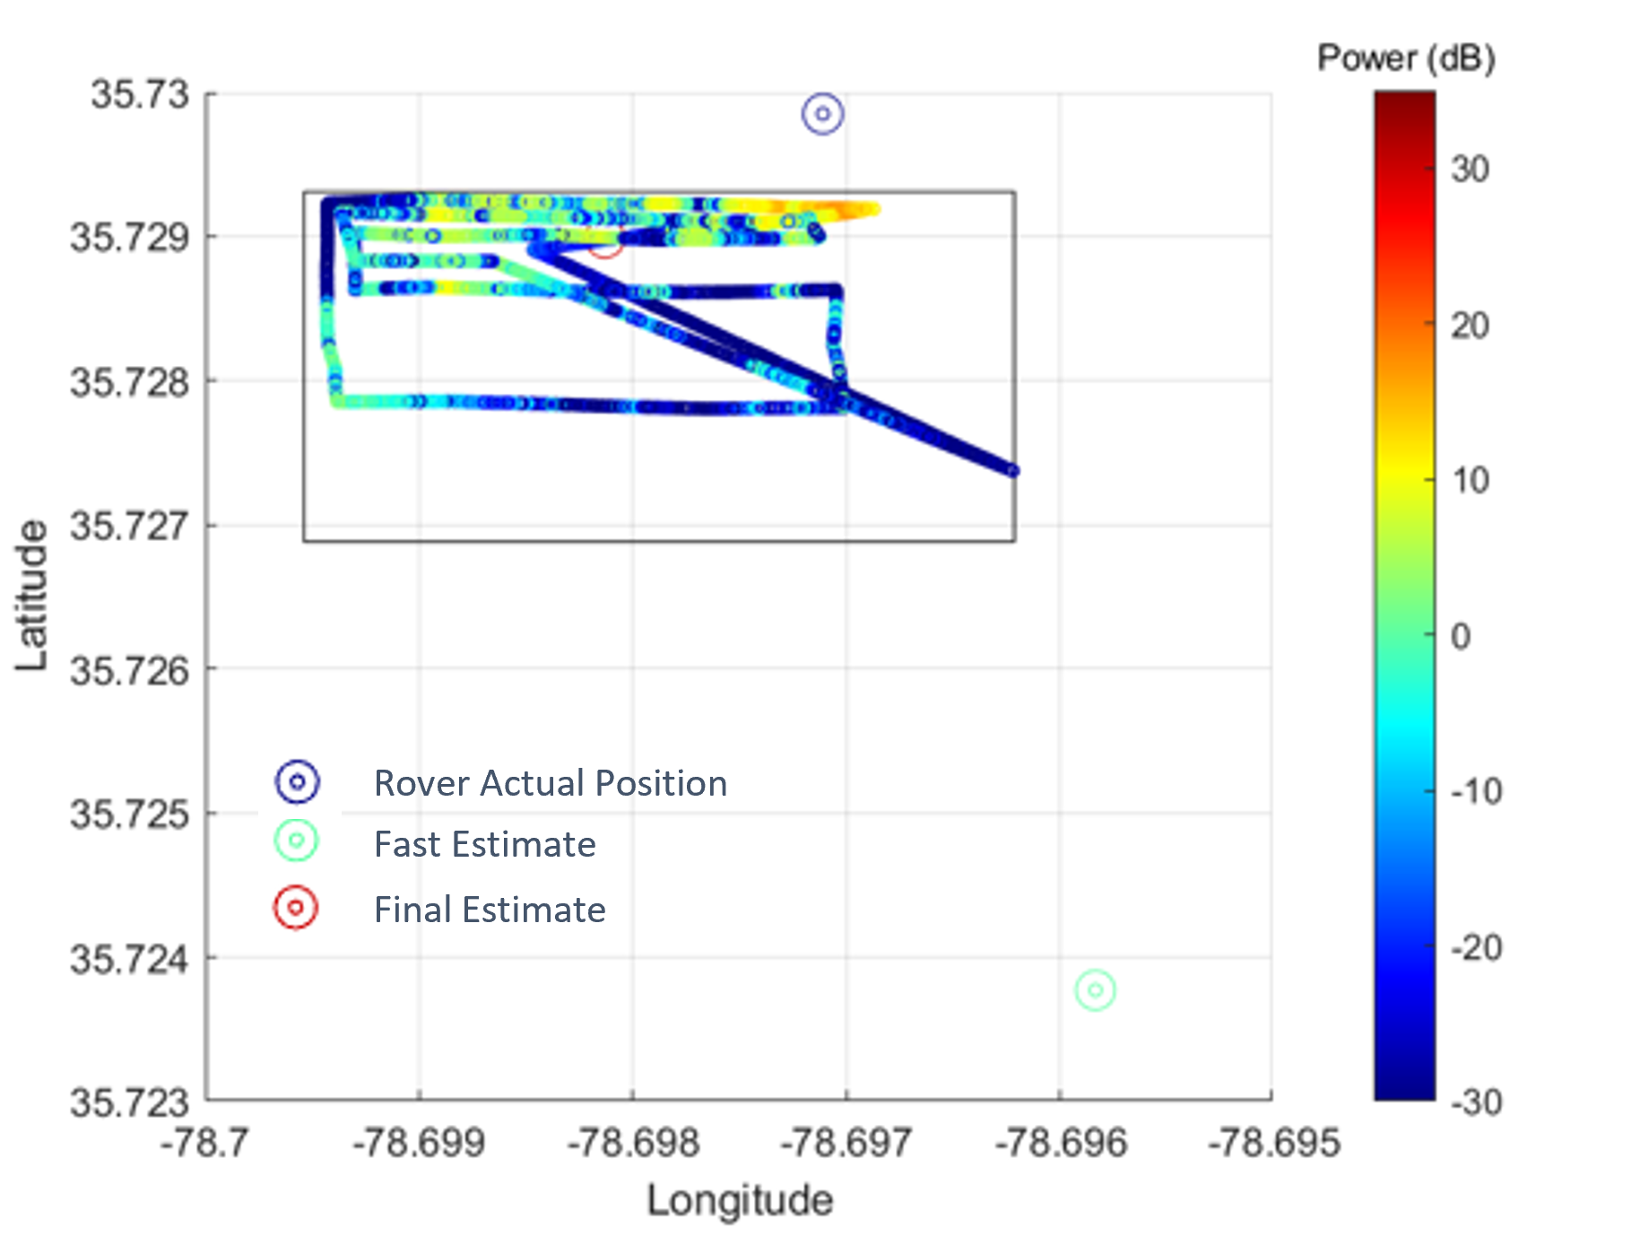
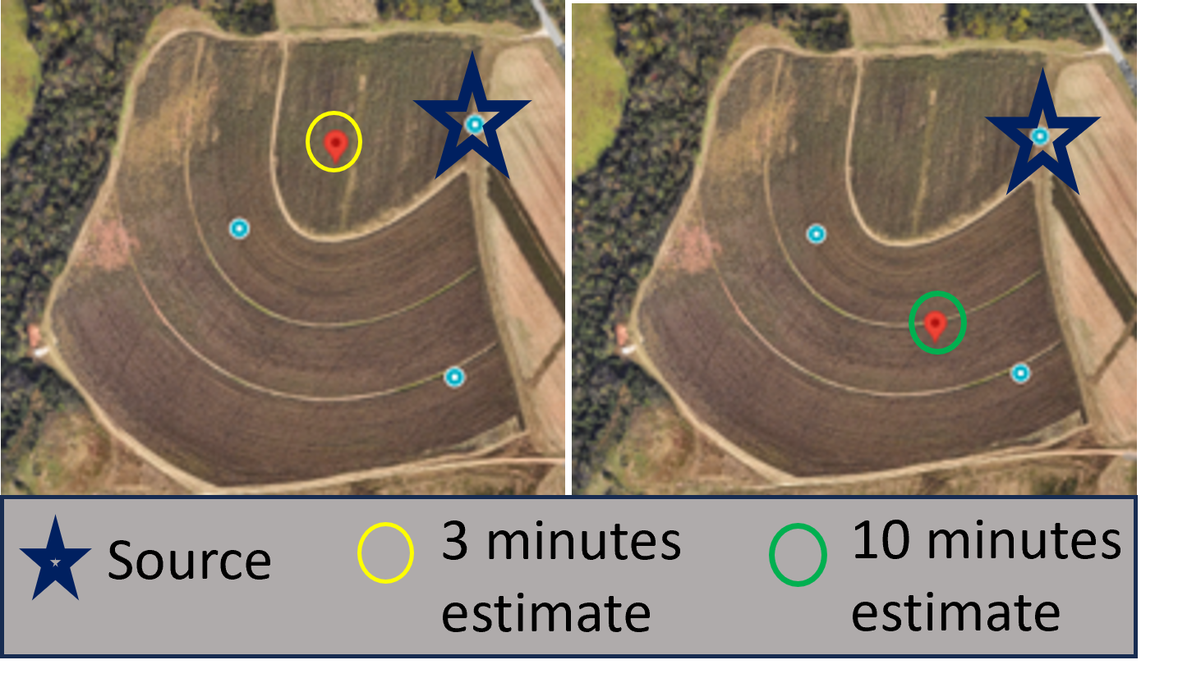
Test Case 3 : Rover Outside UAV Flight Boundary
Emulation
Error 3-min : 203.7m
Error 10-min : 139.1m
Test Bed
Error 3-min : 691.7m
Error 10-min : 148.8m

Slide 16
CLOSING REMARKS

Slide 17
SUMMARY & FUTURE WORK
We have demonstrated our implementation of a wireless source localization algorithm using a UAV on the AERPAW testbed
We compared its performance on Testbed against the Digital Twin Emulation environment.
Results show that the Digital Twin is a near-identical copy of the real life environments
However, some changes do exist and real-life conditions can alter certain results.
For test cases 1 and 2, our algorithm performed better in testbed
We believe this is because degradation of quality was not a factor in emulation, but was considered and handled in testbed
For test case 3, our algorithm showed a large error margin in real life, but not in emulation
In future, we plan to perform further experiments on the testbed and are currently working on implementations where multiple UAVs need to communicate with each other in order to complete a task.

Slide 18
Thank you

